Slide 1
IBM CAPSTONE PROJECT
Moving to Madrid

Slide 2


1. Introduction
Deciding where to move is a big decision. Especially if you don’t know the city and when several people are involved, including their belongings, luggage, furniture, etc. This decision can be better made with some data science to back it up and make sure it is the right one from the beginning.
There are several key aspects:
budget or price per square foot
criminal rate
communications
finding in that neighborhood what matters to the person that is moving.
We are going to focus on the latest.
In this project, we are going use data science and Foursquare to recommend families with children interested in moving to Madrid which neighborhood(s) to choose depending on the venues that are more important to them. That would be schools, daycare centers, parks and groceries.

Slide 3
2. Data description and cleaning
Data sources:
Borughs and neighborhoods in Madrid from Wikipedia
Latitude and longitude of each neighborhood using Geopy library
High criminality and noisy boroughs from City Council of Madrid, so that we can discard them as they are not recommendable for families.
Number of each desired venue and Top 10 venues by neighborhood from Foursquare data

Slide 4
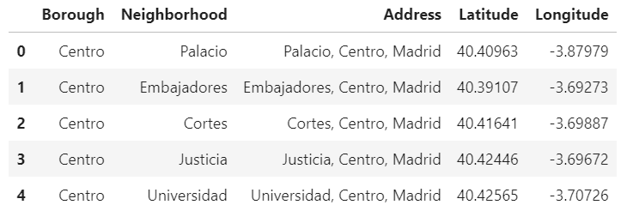
Data cleaning and selection
After downloading the information about boroughs and neighborhoods, we get the coordinates of each neighborhood using Geopy library. To do that, we just need the address formed by the name of the neighborhood and borough, creating a string. This is what we get:

Slide 5

Madrid has 21 boroughs and 131 neighborhoods.
To reduce the number of neighborhoods to be compared, we exclude boroughs with high criminality. This includes:
Boroughs with high number of people arrested (for any reason)
Boroughs with high number of complaints related to alcohol, usually drinking in the street which is not allowed
Boroughs with high number of businesses complaints, this includes complaints about noise, sanitary and others
This way the number of boroughs to study is reduced to 4: Arganzuela, Retiro, Chamartín and Villa de Vallecas; and 22 neighborhoods.

Slide 6

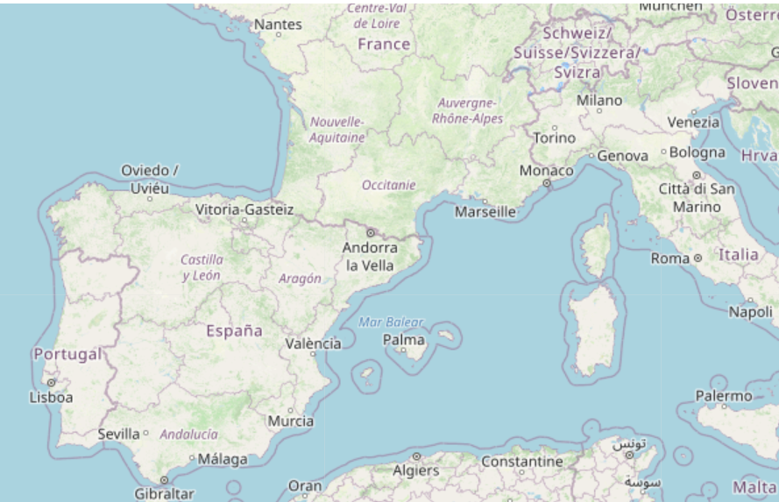
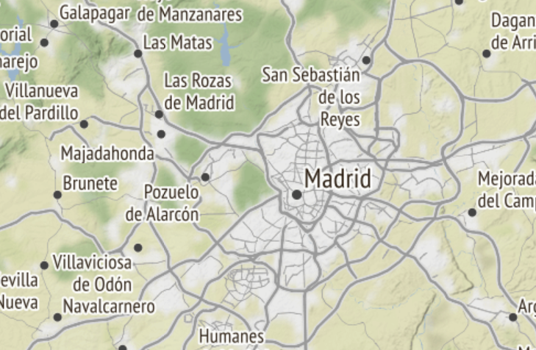
3. Methodology
3.1. Maps

Slide 7
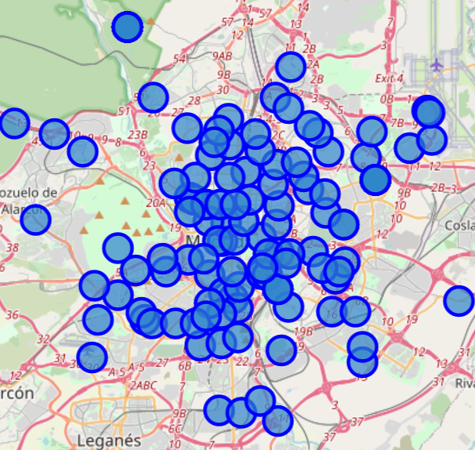
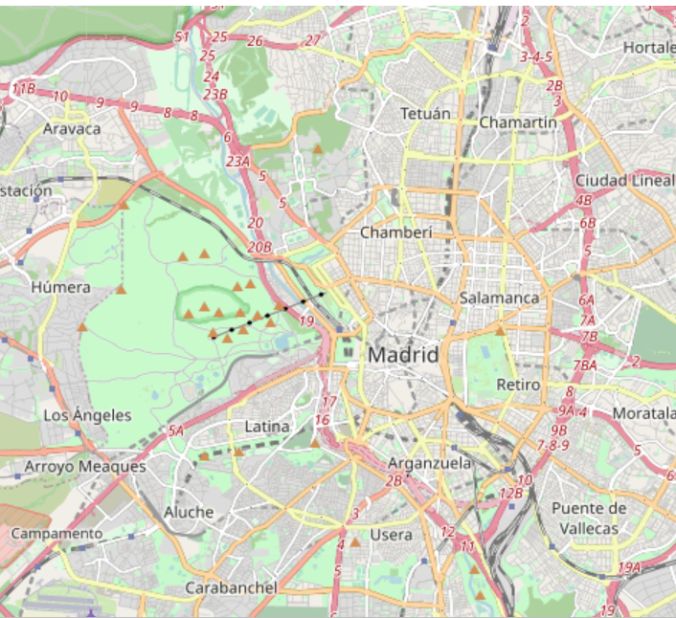
Map of the center of Madrid
With neighborhoods
Without neighborhoods

Slide 8
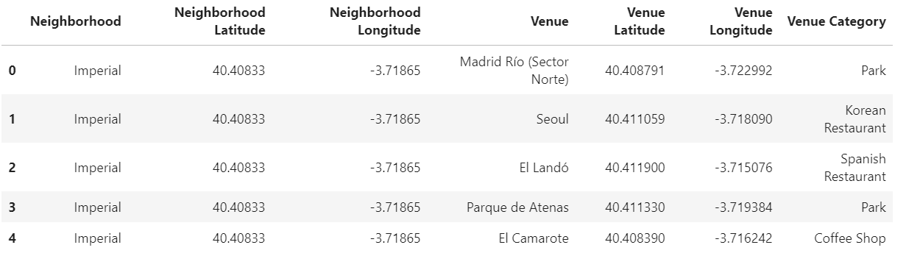
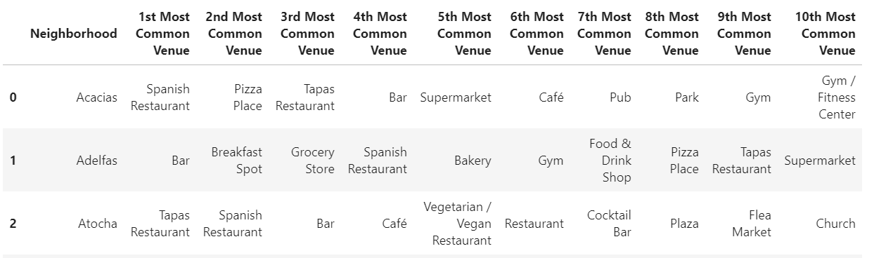
3.2. Foursquare and venues
We get all the venues in the boroughs we are interested in: 757 venues in those 22 neighborhoods, 143 unique categories
Top 10 venues by neighborhood:

Slide 9
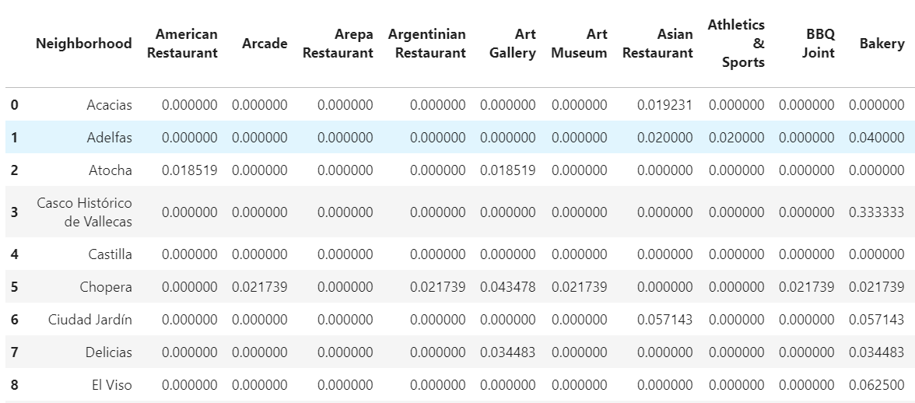
Grouping the venues of each neighborhood and displaying them taking the mean of the frequency of occurrence of each category:

Slide 10
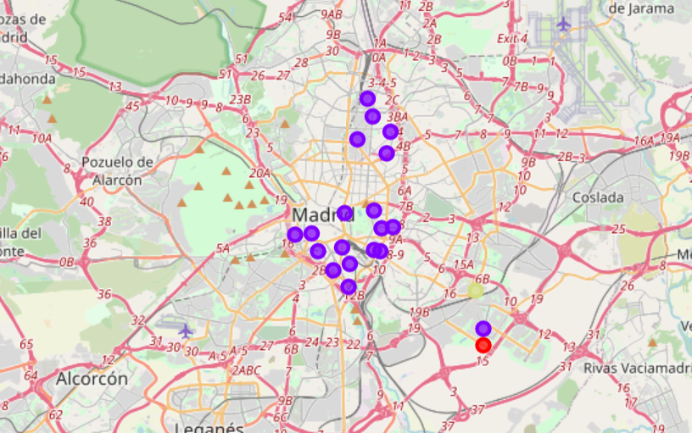


3.2. Clustering Neighborhoods
We run k-means algorithm to cluster the neighborhood into 4 clusters. We use the Folium library to visualize the neighborhoods in Madrid and their emerging clusters.
Cluster 1. Basically based on food shops with a slight touch of outdoors activities.
Cluster 2. In this cluster we find most neighborhoods we have previously selected. They are very alike.
Cluster 3. Most venues are markets and restaurant businesses. Therefore, it is not very recommendable for our purpose.
Cluster 4. There are gyms and other type of businesses non-related to our purpose.

Slide 11

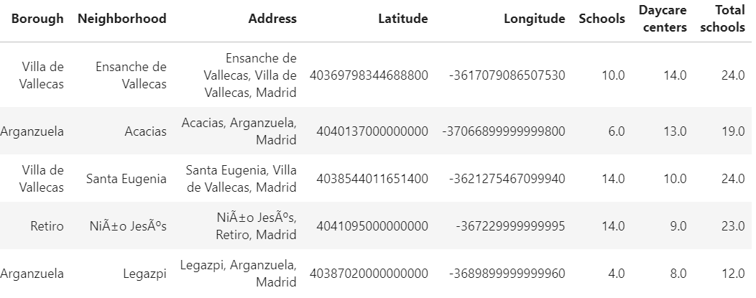
4. Discussion
As seen before, our perfect neighborhood should be in cluster 1 or cluster 2.
On Foursquare no information about schools and daycare centers is available, which would be a must-have in this case.
We have extracted this information from other tool, we used Googleapis by proximity, put it into a dataframe and sorted it by higher values
The neighborhoods with most daycare centers and schools are: Ensanche, Acacias, Niño Jesus and Santa Eugenia.
Santa Eugenia is Cluster 4 (Others) non-recommendable for our purpose.

Slide 12
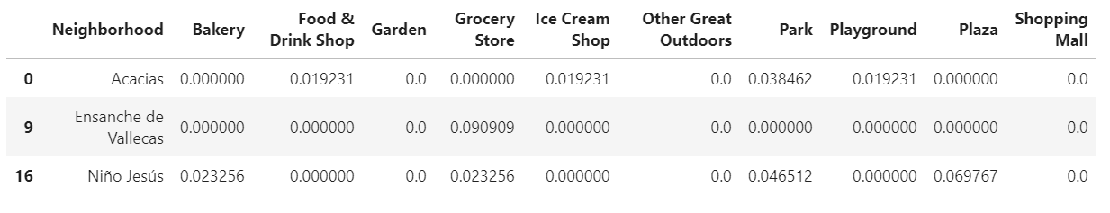
We have narrowed the number of boroughs/neighborhoods regarding the type of neighborhood.
We would also need to select it depending on the important venues. We have listed them for the narrowed list of neighborhoods, getting:
As it can be seen, Ensanche has no parks of playgrounds, so it is not recommendable for families with children.
Niño Jesus is the neighborhood families would be most interested to live in and Acacias the second one for having everything they will need close by.

Slide 13

6. Conclusions and Future directions
Madrid is a wide city with a wide range of neighborhoods and deciding which neighborhood moving to can be tricky specially if you are a foreigner. By using data science, we have reduced the number of districts of interest and analyzed them.
This study has focused on one type of interested people: families with children. However, it is important to highlight that this study can be flexible and customized depending on the type of interested profile. For example, young couple or single youngsters may be interested in moving into other types of neighborhoods: livelier and with more leisure areas.
Also, it can be used the other way around. Analyzing the venues of each neighborhood, we can tell the profile of the people living there. This can be useful for new businesses and for advertising campaign.

Slide 14
7. References
[1] Wikipedia: https://es.wikipedia.org/wiki/Anexo:Barrios_administrativos_de_Madrid
[2] Geopy library
[3] City Council of Madrid:
https://datos.madrid.es/egob/catalogo/212616-74-policia-estadisticas.xlsx
[4] Forsquare API
[5] Google Map

